Slide 1
Armenian New Year and Christmas

Slide 2
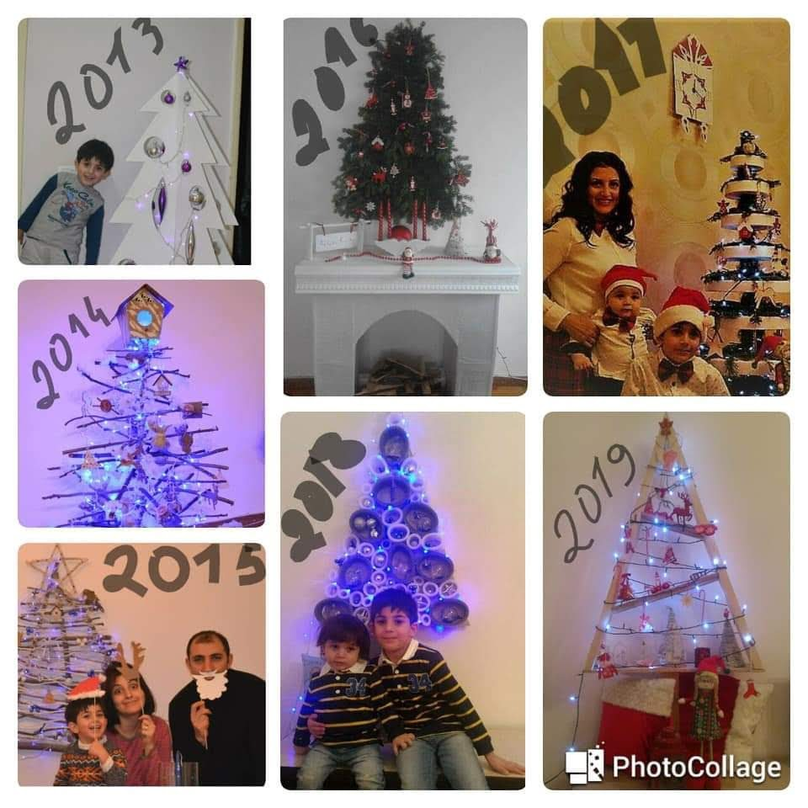
Christmas tree
Every year there is a tradition in our family that we need to build Christmas tree ourselves. This year we are gonna build a new one!

Slide 3
Armenian traditional pork leg
Our family does cook pork leg every year. When I was looking for a pork leg picture I wanted the pork leg so much, because its yummy! I am impatiently waiting for New Year.

Slide 4
Armenian “Ishli Qyufta”
In Armenia many families do traditional “Ishli Qyufta” and in 1-2 of them there is a coin. Which person gets the “Ishli Qyufta” with a coin, he|she will be lucky for a year.

